Slide 1
A Case-Study on Materials used in Electric Vehicles
by
Gurunathan. C
cgurunathan@iiitdm.ac.in

Slide 2
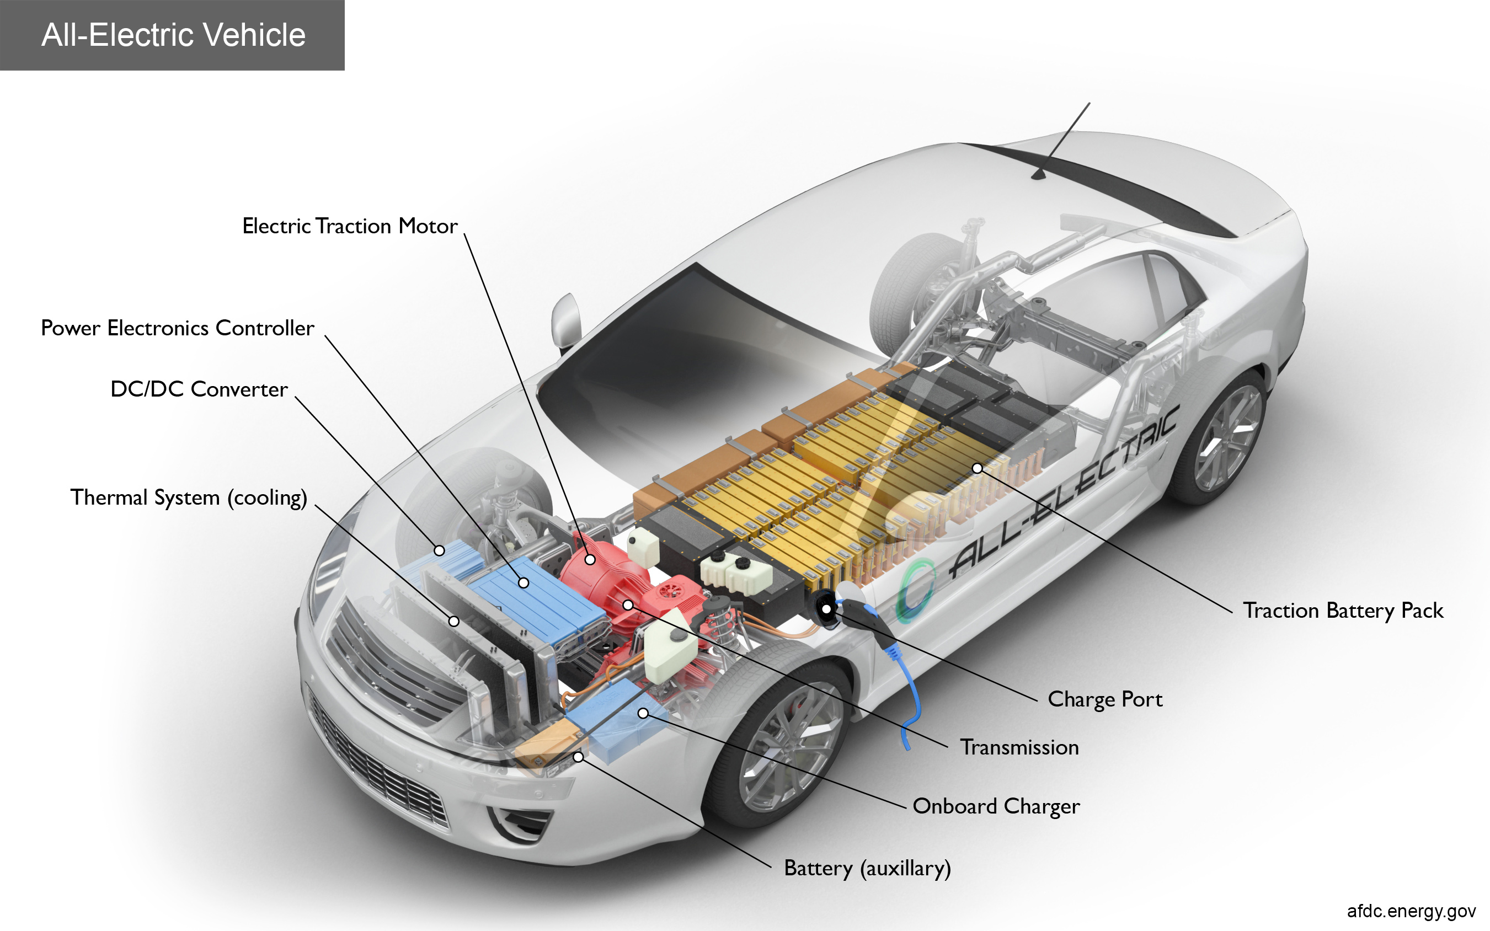
Electric Vehicle – Overview of Components
Lightweight components results reduced overall weight – energy efficient vehicle
Electrical energy is stored in the battery and is converted in to mechanical energy in the electric motor to propel the wheel of EVs
Lightweight materials with better performance characteristics are needed for electric vehicles
Critical components: Battery and Electric Motor
Ref: https://afdc.energy.gov/vehicles/how-do-all-electric-cars-work

Slide 3
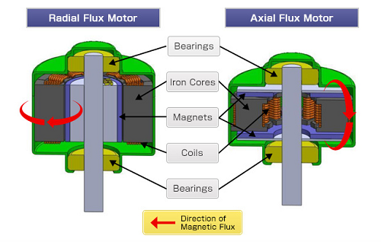
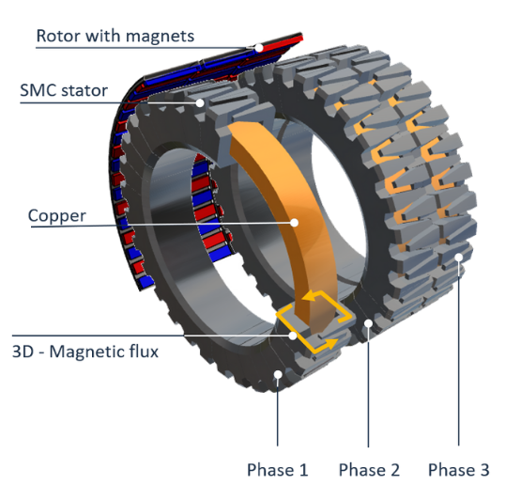
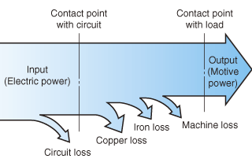
Electric Motors for EVs
Basic components of electric motor:
Stationary part – stator – attached to frame/chassis
Rotating part – rotor – attached to shaft and wheel
Electric motors classification based on the orientation of the magnetic field to the electric coils:
Radial flux motor – uses permanent magnet – large in size
Axial flux motor – High power density – compact in size
Transverse flux Motor – Better efficiency – no cooling
Transverse flux Motor:
Axial and transverse motors offers higher torque while reducing their motor footprint – more promising for EVs
EV Design requirements:
Lightweight materials to reduce overall weight and for energy saving
Different properties at different parts of the motor – High thermal and electrical conductivity at some parts and insulation property at some other parts
Materials that can reduce losses – for energy efficient system
Typical power losses in electrical motor:
https://www.horizontechnology.biz/blog/electric-motor-design-radial-vs.-axial-transverse-flux

Slide 4
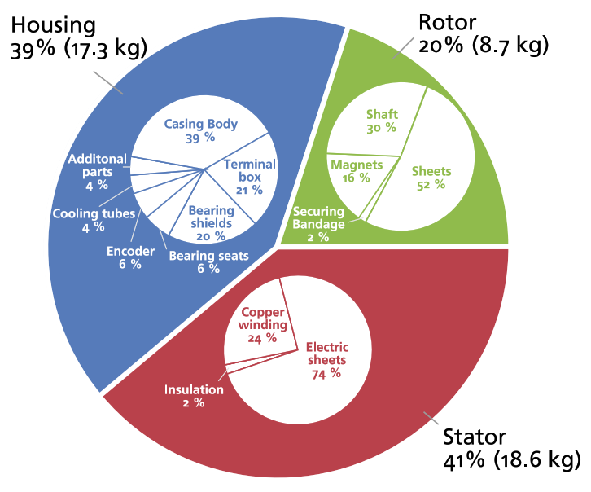
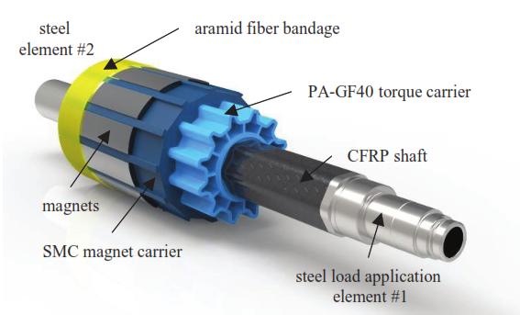
Materials in Electric Motors
Energy loss reduction methods:
Use of copper wire in the stator and aluminum wire in the rotor minimize motor resistance losses.
Enhanced rotor configuration and optimized air gap between stator and rotor results in stray loss reduction
Optimized design of the cooling fan minimize windage loss
Thinner and higher-quality rotor and stator core steel laminations reduces magnetization losses
High quality bearings reduces frictional losses
Weight distribution in electric motor
Weight reduction methods:
Fiber reinforced plastics (FRP) reduce weight and increase mechanical and electrical properties
Aluminum matrix composites (AMC) are used to improve the motor efficiency by a considerable weight reduction
Carbon fiber reinforced materials with metal pins are used for reducing weight and to increase thermal conductivity
Use of high modulus fibers increase damping properties and reduce noise produced by electric motors.
Soft magnetic composites (SMC) are used for achieving high power to weight ratio with reduced magnetic losses
Lightweight permanent magnet rotor
Ref: Koch SF et al., Procedia CIRP 66 (2017), 283 – 288

Slide 5
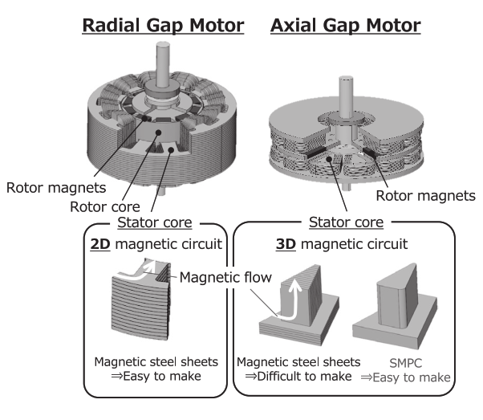
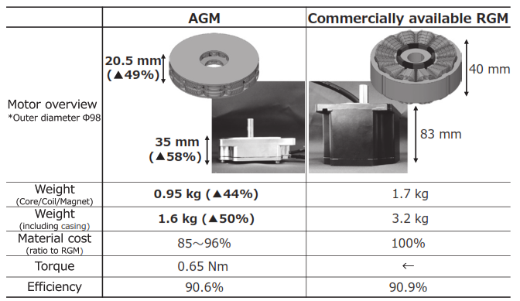
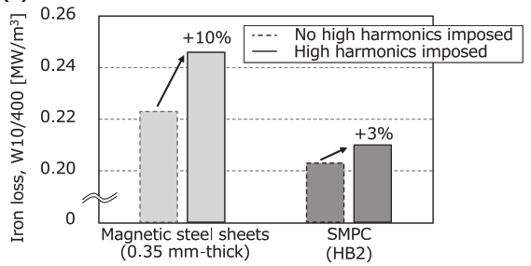
Soft Magnetic Composites – SMCs
SMCs are materials consisting of metallic magnetic particles which are insulated from each other by nonconductive organic or inorganic materials.
Advantages of SMCs over laminated steel cores:
Three-dimensional isotropic magnetic ﬁelds
High magnetic permeability
Low eddy-current losses
High saturation magnetic induction
Flexible machine design and assembly
Greatly reduce weight and production cost
Ref: Saito et al., Sumitomo Electric Technical Review (2021), 92, 47

Slide 6
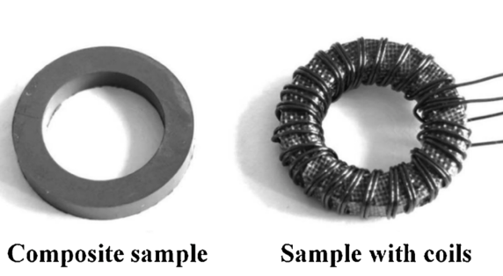
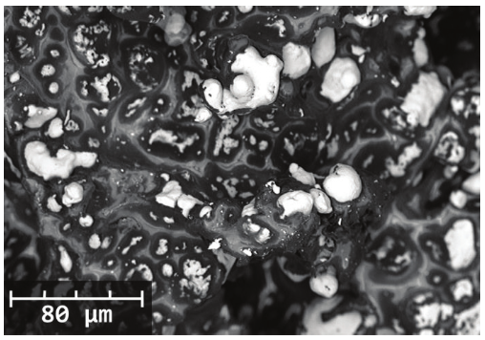
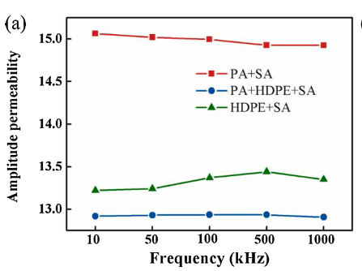
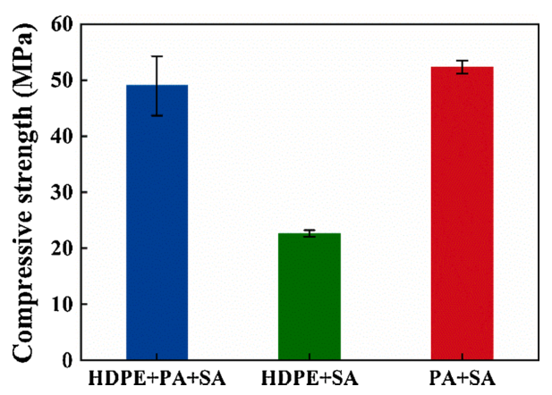
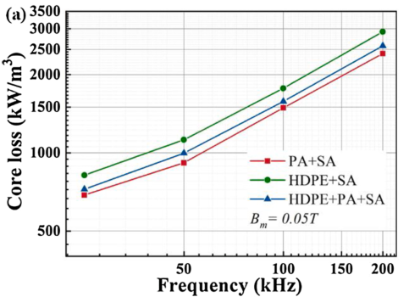
Effect of Matrix Material in SMC Properties
V_{f}: 58%; V_{m}: 42%
Matrix materials: polyamide 66 (PA); high-density poly-ethylene
Particles: Iron-based amorphous powder (Fe₇₈Si₉B₁₃), 10.9 μm size
Surfactant: Stearic acid (SA) – to decreases surface energy of particles
Manufacturing process: Metal injection molding process
The interaction between amino in PA and carboxyl in SA results very good bonding between the matrix and the iron particles –> results in pore-free composite with better mechanical and dynamic magnetic properties.
The weak bonding between the HDPE matrix and the metal particles results in decreased magnetic and mechanical properties.
The degree of bond between the particles and matrix governs the properties of composite material
SEM images of SMC. Light areas: Iron particles, Dark areas: Matrix materials
5% + 90% + 5%
95% + 5%
95% + 5%
Ref: Rui Ma, Materials Research Bulletin 139 (2021) 111256

Slide 7
Thank you

